Slide 1
Forecasting ESG score Based on 10-K Annual Reports
20240419 TEN MFS.key

Slide 2
Purpose of this project
Data Introduction
EDA
Feature selection
Model selection
Training and Testing
Performance
Prediction

Slide 3
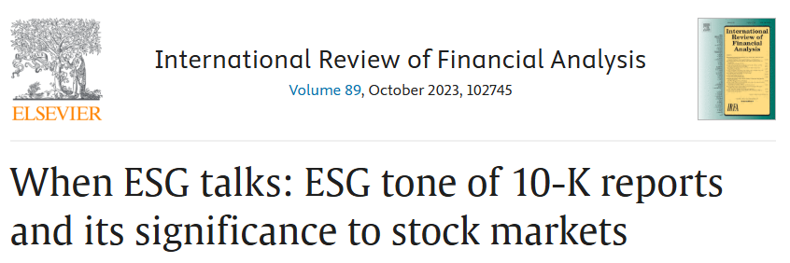
Purpose of this project -> Predict company 2024 ESG score
Company ESG score has positive relationship with stock performance
Predict company ESG score by 10K annual report
Title

Slide 4
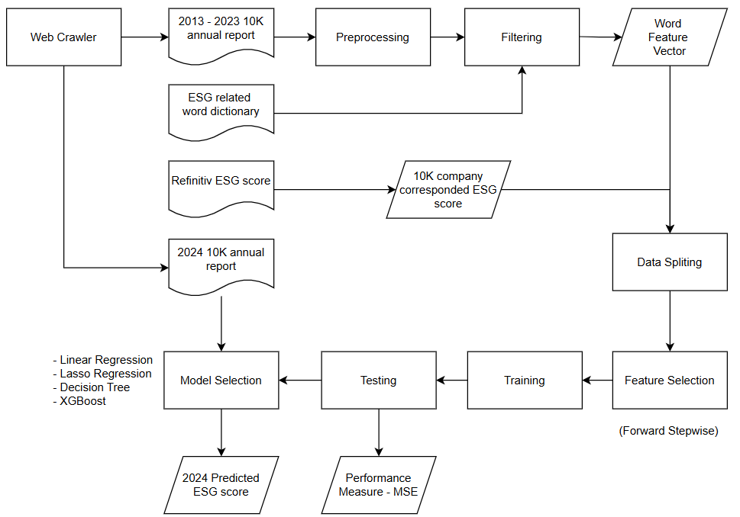
Flow Chart
Flowchart

Slide 5
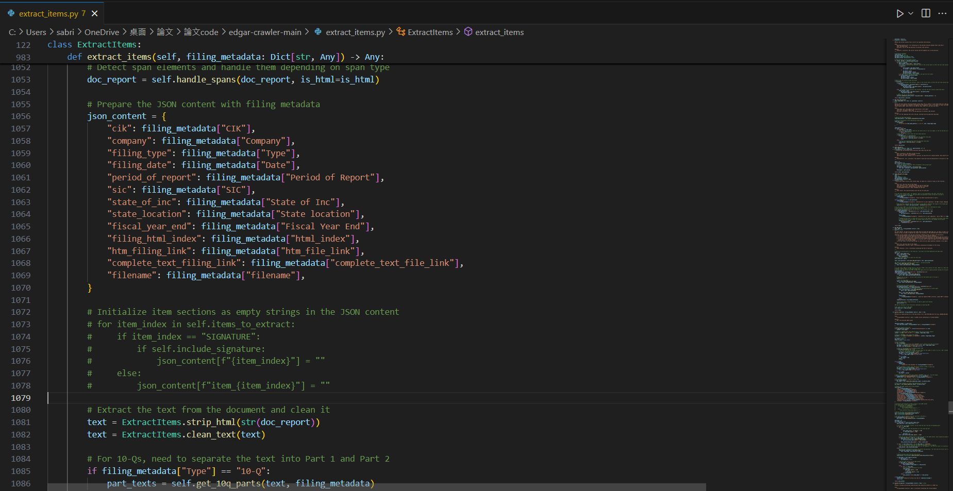
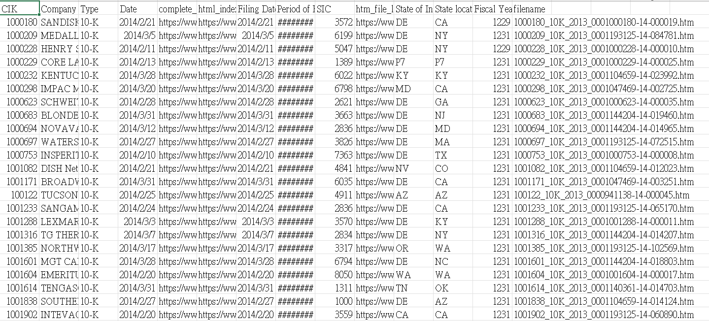
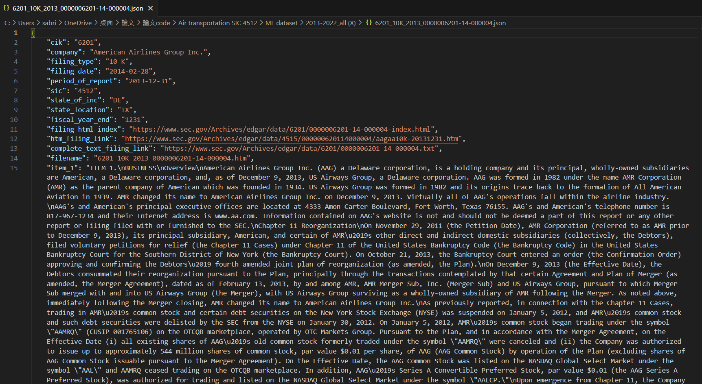
Method
Web crawling
Collect target companies’ 10K annual report from SEC website
Target：US airline industry
Title

Slide 6
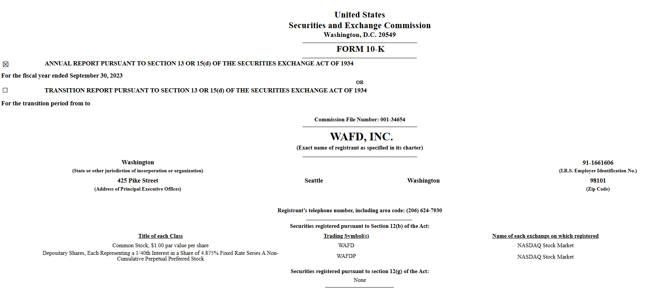
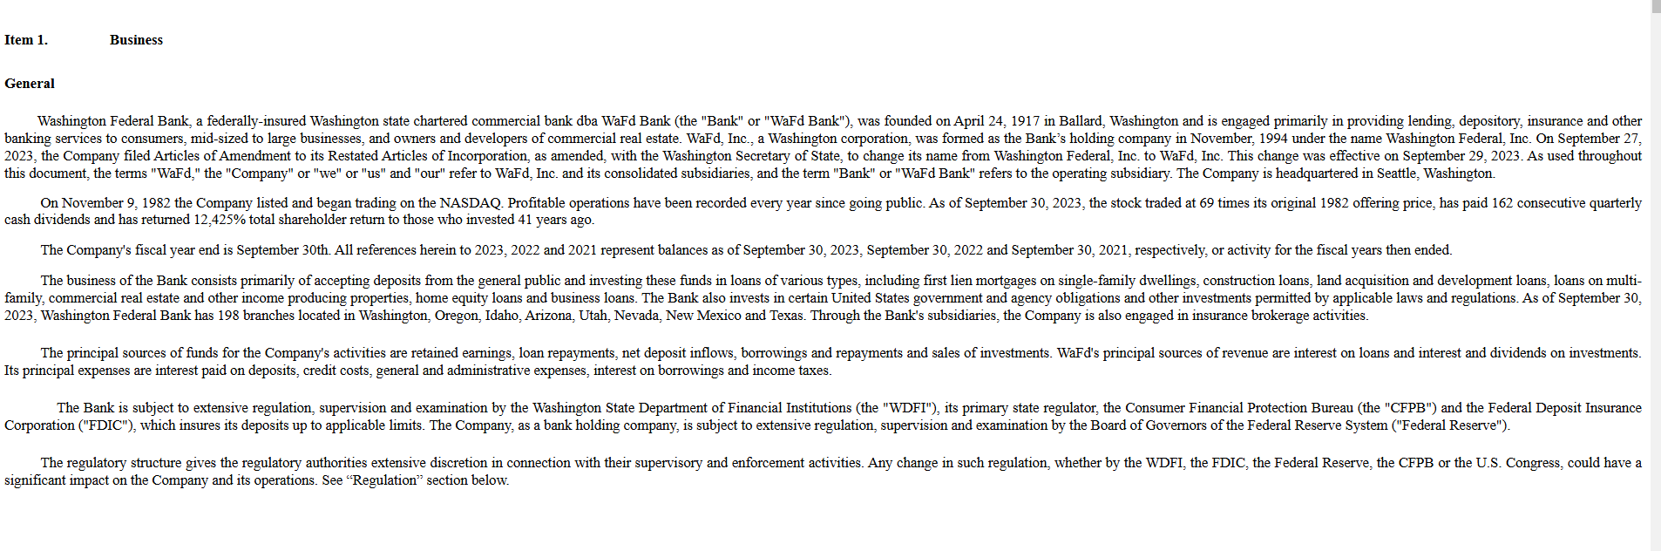
Method
Data Introduction
10K annual report (2013-2024)
Refinitiv ESG score(2013-2024) (scoring from 0-100)s
ESG wordlist (Baier et al. (2020))
Title

Slide 7
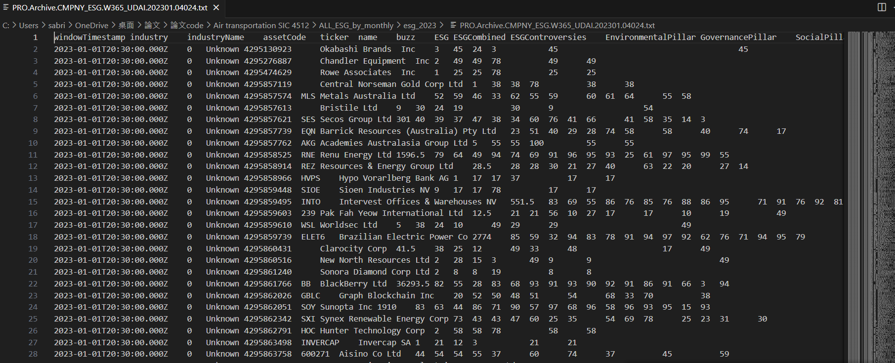
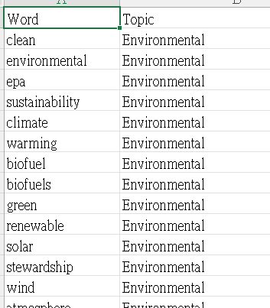
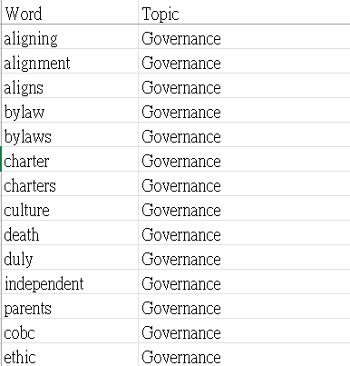
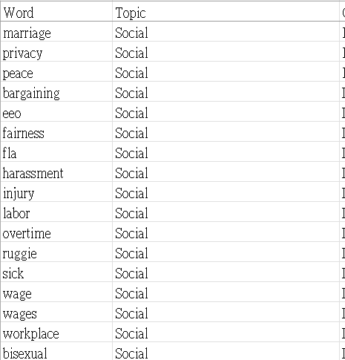

Method
Data Introduction
Title

Slide 8
Method
Data Preprocessing
For 10K：
# Decode any Unicode escape sequences
# Remove numbers
# Replace multiple spaces with a single space
# Lowercasing
# Remove punctuation
# Remove stopwords and lemmatize
# Filter the text using ESG Dictionary
For Refinitiv ESG score
# Averaging monthly score to annual score for every target company
Title

Slide 9
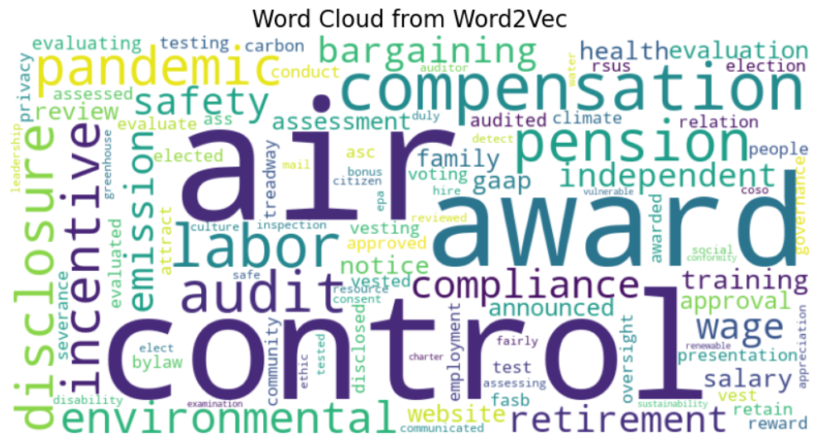
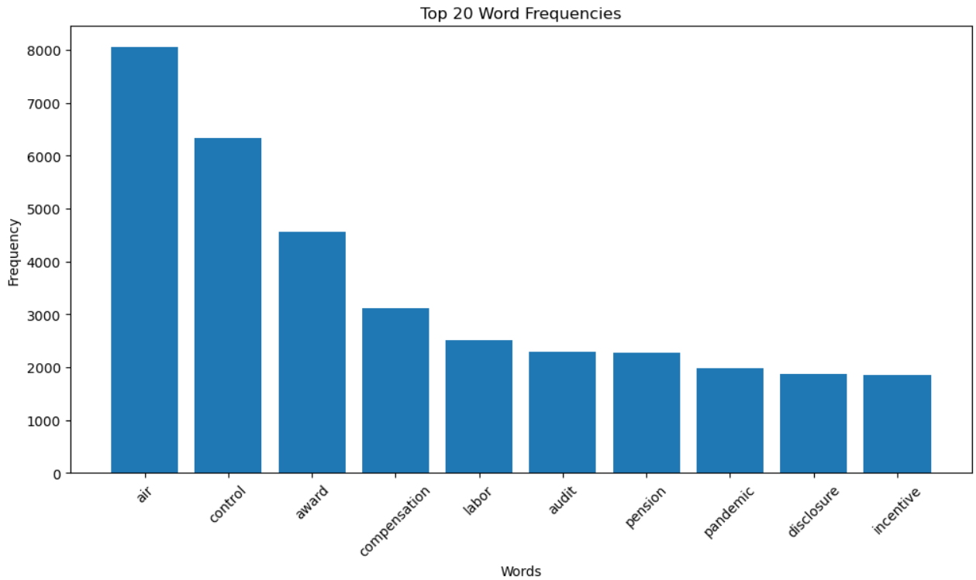
Method
EDA
Title

Slide 10
Method
Embedding and Parameter Setting
Using Word2vec to create word feature vector
Date split：80% train data, 20% test data
Feature Selection： forward stepwise
Title

Slide 11
Method
Model Selection
Linear Regression Test MSE: 317.68
Lasso Regression Test MSE: 39.80
Decision Tree Test MSE: 101.61
XGBoost Test MSE : 46.01
Title

Slide 12
Method
ESG Score Prediction (Using Lasso Regression)
American Airlines Group Inc. ：88.68
DELTA AIR LINES INC /DE/ ：72.00
SOUTHWEST AIRLINES CO ：67.22
United Continental Holdings, Inc. ：52.93
ALASKA AIR GROUP, INC. ：59.57
SKYWEST INC ：48.25
JETBLUE AIRWAYS CORP：51.5
Spirit Airlines, Inc.：75.5
Title

Slide 13
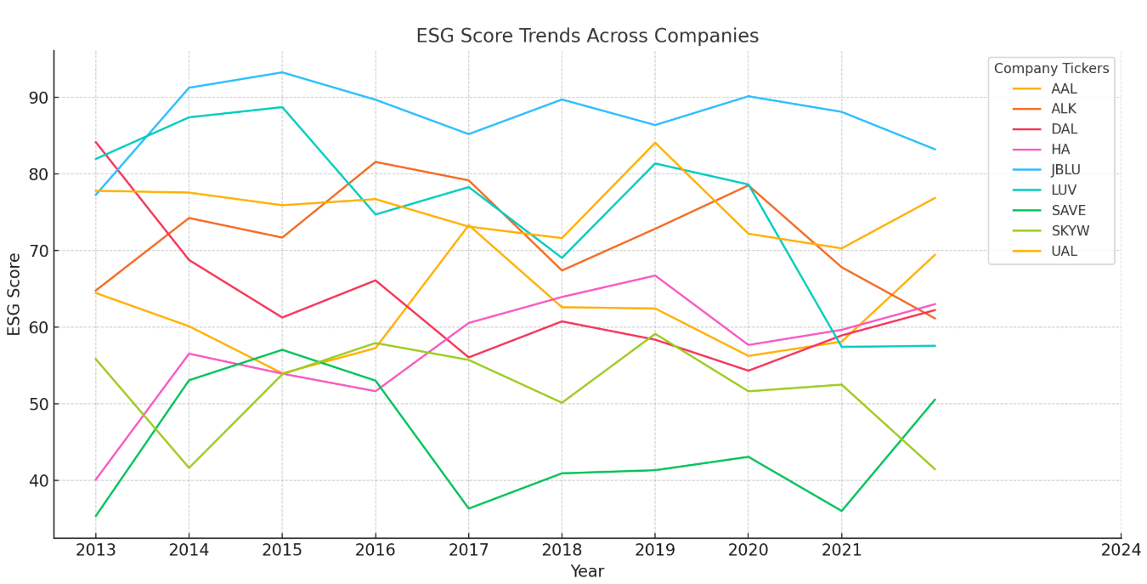
Method
Conclusion
Title

Slide 14
Thanks for listening
Title

